Slide 1


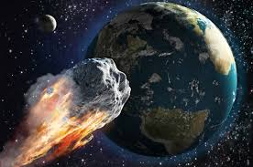
Project 3 Shooting for the Stars…
Group Members:
Kevin Ewing
Kent Hazen
Kerwin Hsu
Fred Tinio

Slide 2
Shooting for the stars…
Meteorites
Only a small fraction of this world’s population as ever seen a meteorite fall. The purpose of this project is to explore and visualize information about all know meteorite landings. Some specific information about the meteorite landings to show include the name of the meteorite, the meteorite’s ID, the mass, recclass, and the year the meteorite was found.
Data Sources
We used several data sources to processes to cleanse and prep files in the following formats:
CSV files /.txt files / Spreadsheets
https://data.nasa.gov/ (.txt converted to csv)
Specific Requirements
We used several techniques to process, cleanse and prep the data files utilizing the following techniques:
JS Library
JSON Files
Jupyte Notebook MySQL Server
Flask
Pandas
JSON
JSON
JSON
JSON
FLASK

Slide 3
What is a Meteorite
Meteorite:
Is a solid piece of debris from an object, such as a comet, asteroid, or meteoroid, that originates in outer space and survives passage through the atmosphere to reach the surface of a planet or moon. When the object enters the atmosphere, gases cause to heat up and radiate that energy, it then becomes a meteor and forms a fireball, also known as a shooting star or falling star. Some of the biggest and brightest called “bolides” is large enough to create an impact crater.
Meteorite Classifications:
Traditional classification schemes are divided into three overall categories based on whether they are dominantly composed:
Rocky material (Stony meteorites)
Metallic material (Iron meteorites)
Mixture (Stony-iron meteorites)

Slide 4
XXX

Slide 5
XXX

Slide 6
XXX

Slide 7
XXX

Slide 9
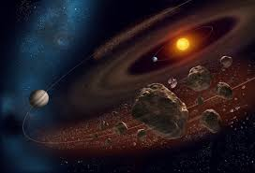
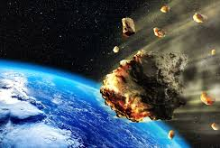
In conclusion

Slide 10
Appendix

